Slide 1
Introduction to Articulate
Presented by Lili Steiner & Judith Slapak-Barski
Faculty Retreat, April 2012 Abraham S. Fischler School of Education, Nova Southeastern University
Introduction to Articulate Studio ’09
Created by NDLR Training Programme 2010-2011
Edited by Lili Steiner & Judith Slapak-Barski

Slide 2
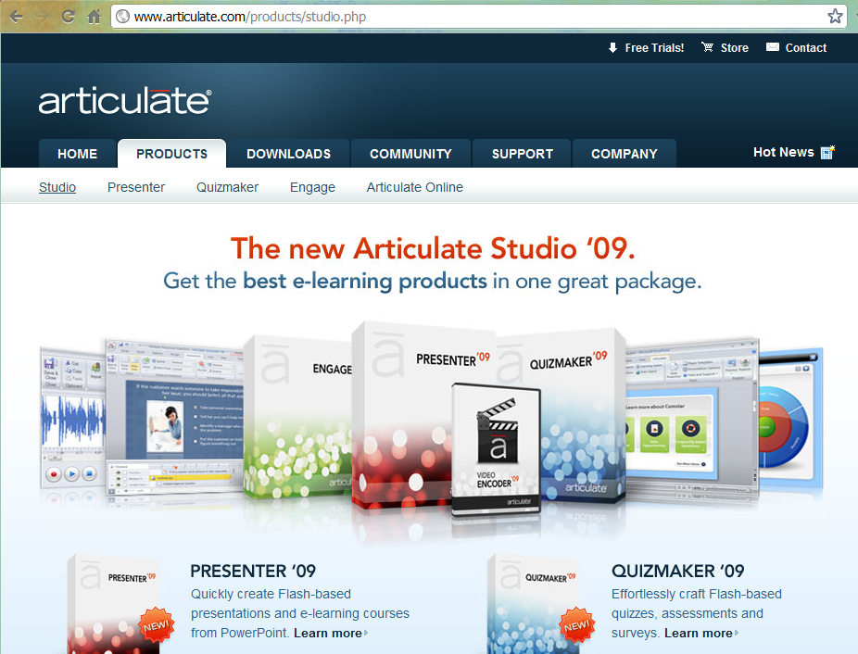
www.articulate.com

Slide 3
Articulate - Key features
Ease of Use
Cost
Import & Export from/to many popular formats
Scorm compliant

Slide 4
Video Encoder - features
Convert format to flash video
Basic editing : cut, copy, crop, audio
Add a logo
Webcam

Slide 5
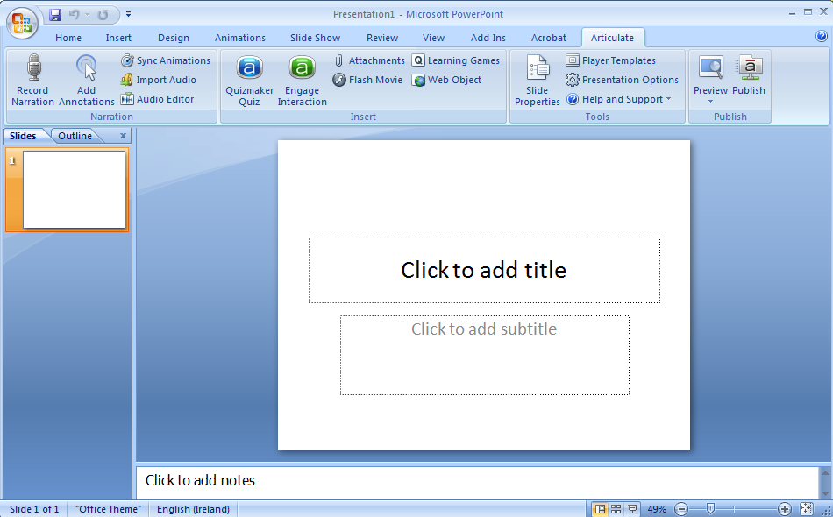
Articulate Menu

Slide 6
Articulate Menu

Slide 7
Articulate Menu

Slide 8
Articulate Menu

Slide 9
Examples by Dr. Charles Schlosser, Fischler School of Education, NSU

Slide 10
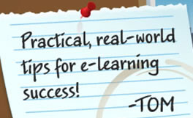
Resources
www.articulate.com/rapid-elearning
what-everybody-ought-to-know-about-using-powerpoint-for-e-learning
a-free-powerpoint-template-how-i-made-it
another-free-powerpoint-e-learning-template
here-are-more-than-200-free-rapid-e-learning-tutorials/
www.articulate.com/blog/101-rapid-e-learning-tutorials/

Slide 11
Tutorials
Jeanette brooks
How to build a knowledge-check for your #elearning course by using an #Articulate Engage Tabs Interaction
Building branched scenarios
How to add a movie to the presenter panel of your #Articulate Presenter project :
How to simulate a pop-up box in #PowerPoint or #Articulate Presenter
Turn off sound effects in Engage:
Articulate live demo www.articulate.com/products/daily-demo.php

Slide 12
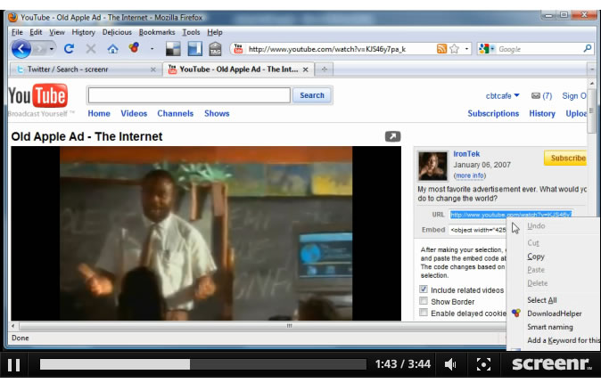
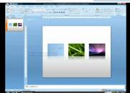
Other tutorials
Insert a YouTube video into Presenter
PowerPoint
2007 Effects
backgrounds in Powerpoint
www.kineo.com

Slide 13
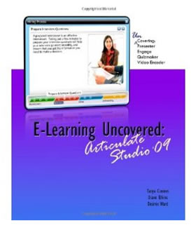
Other tutorials
Essential Articulate Studio '09 (Wordware Applications Library)
E-Learning Uncovered: Articulate Studio '09 [Paperback]
Tanya Coomes (Author), Diane Elkins (Author), Desire Ward (Author)

Slide 14
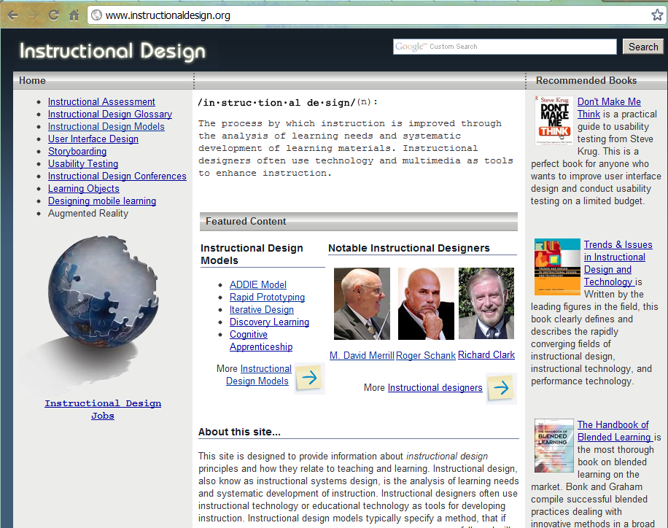
Instructional Design

Slide 15
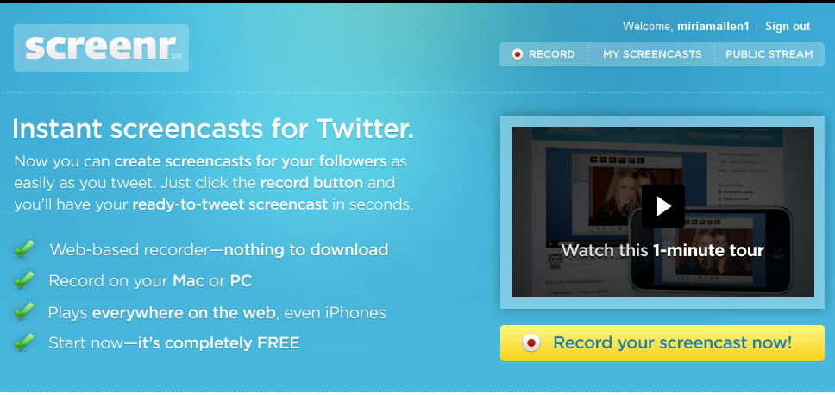
Useful links
http://www.wordle.net/
http://screenr.com/
http://www.nattyware.com/

